Slide 1
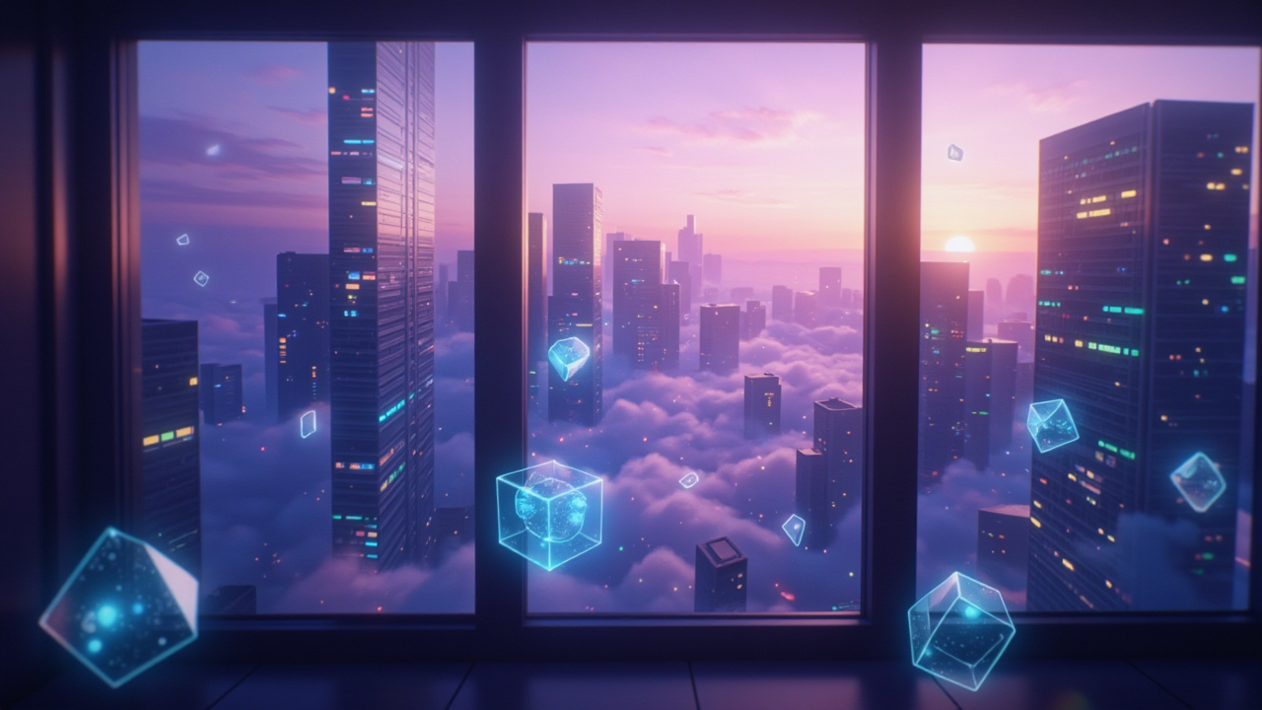
HW02 冒險故事
Notes:
Flux prompt:
A modern cityscape at dawn, viewed through a large window of a high-rise apartment. Tall skyscrapers with illuminated windows stretch into a gradient sky of deep purple fading into soft pink and orange. Multiple layers of holographic computer screens float in the air, displaying lines of glowing code in cyan and green. The window is slightly fogged, with drops of morning condensation. Scattered throughout the scene are geometric shapes - translucent cubes, spheres, and polygons - floating in the air, giving a technological yet dreamlike atmosphere. The cityscape is partially obscured by morning mist, creating a soft, ethereal effect. Minimal neon lights from distant buildings pierce through the dawn haze. The overall color palette focuses on cool tones - purples, blues, and teals - with warm highlights from the rising sun.

Slide 2
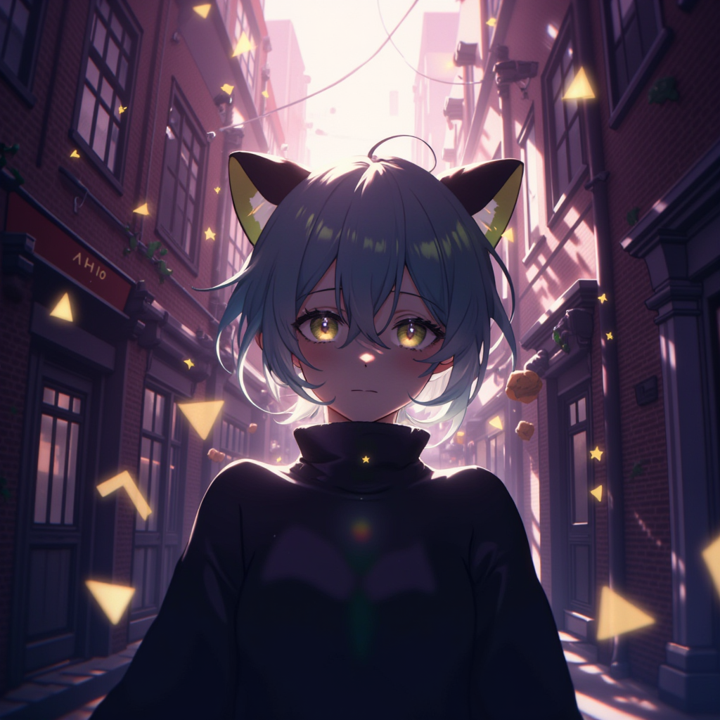
1. 目標
Notes:
Flux prompt: A serene morning scene in a narrow urban alley, featuring an anime-style male character with short navy blue hair with light green highlights. He has distinctive yellow cat-like eyes and black cat ears with light green tips and white fur tufts. He's wearing a high-necked dark sweater that complements his mysterious appearance.
The alley background showcases tall buildings with morning sunlight filtering through, creating long shadows and a mystical atmosphere. The walls are textured with worn brick patterns and occasional vines. The morning sky transitions from deep purple to soft pink, with hints of golden sunlight breaking through.
The scene is enhanced with floating geometric shapes and subtle sparkles in the air, suggesting a magical moment in an otherwise ordinary setting. Soft morning mist lingers at ground level, adding to the dreamlike quality. The lighting emphasizes the character's calm expression while casting gentle shadows across the alley.
Style: Smooth and soft anime rendering with detailed architectural elements and atmospheric lighting, cinematic composition, high quality, detailed background.
Shot angle: Wide shot that captures both the character and the atmospheric alley environment, with the character positioned slightly off-center.

Slide 3
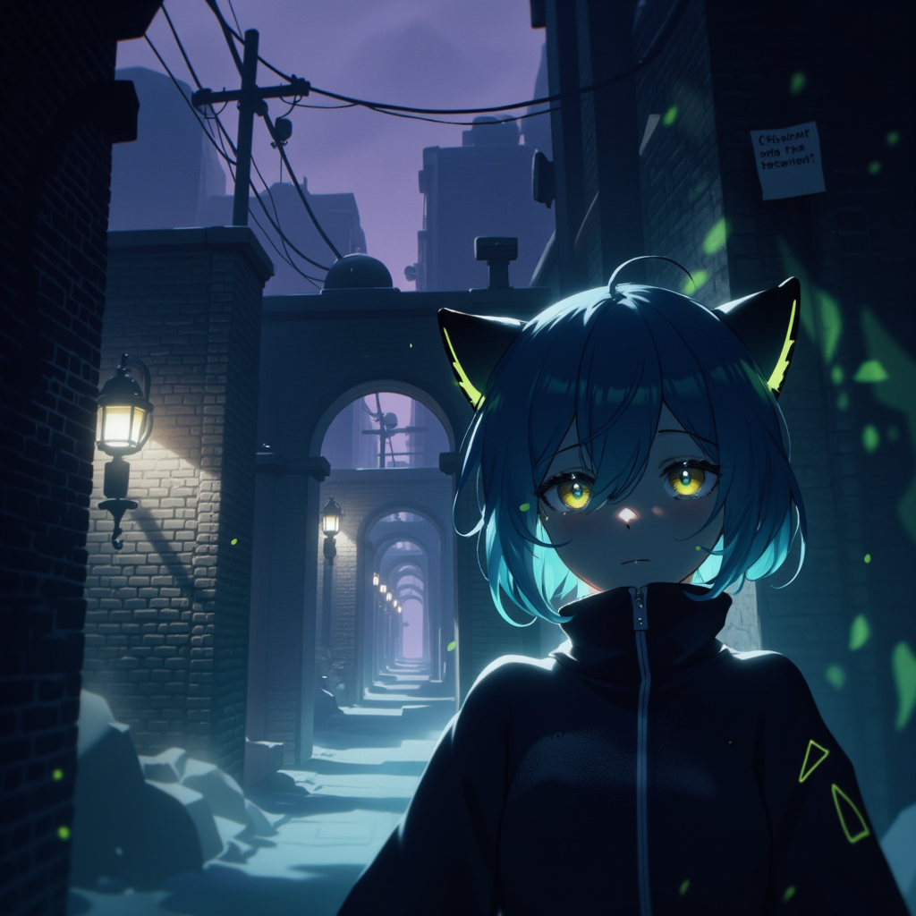
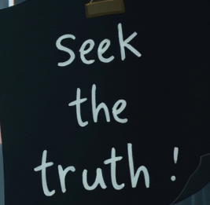
2. 阻礙
Notes:
Flux prompt: A mysterious urban scene featuring an anime male character standing in an endless maze-like alley. The character has short navy blue hair with light green highlights, alert yellow cat-like eyes showing growing anxiety, and black cat ears with light green accents and white tufts. He's wearing a dark turtleneck sweater and has a worried expression. The background depicts a labyrinthine network of narrow alleys with impossibly tall, ancient brick walls that seem to bend and twist unnaturally towards a dark purple sky. The walls are weathered and covered in shadows, with a single dim streetlight casting eerie shadows. A faded note with mysterious text is barely visible on one of the walls. The architecture is a mix of old European and Eastern styles, creating a surreal, dreamlike atmosphere. Multiple identical archways and turns are visible in the distance, suggesting an infinite loop. The lighting is predominantly cool-toned with touches of sickly green, creating an unsettling atmosphere. Fog rolls through the lower parts of the alleys, while the upper sections of buildings fade into darkness. No signs of modern life are visible - no power lines, no satellite dishes, no modern fixtures. The overall color palette is muted and dark, with emphasis on deep blues, purples, and shadows. Cinematic composition, high detail, atmospheric lighting, elements of psychological horror.

Slide 4
2. 阻礙

Slide 5
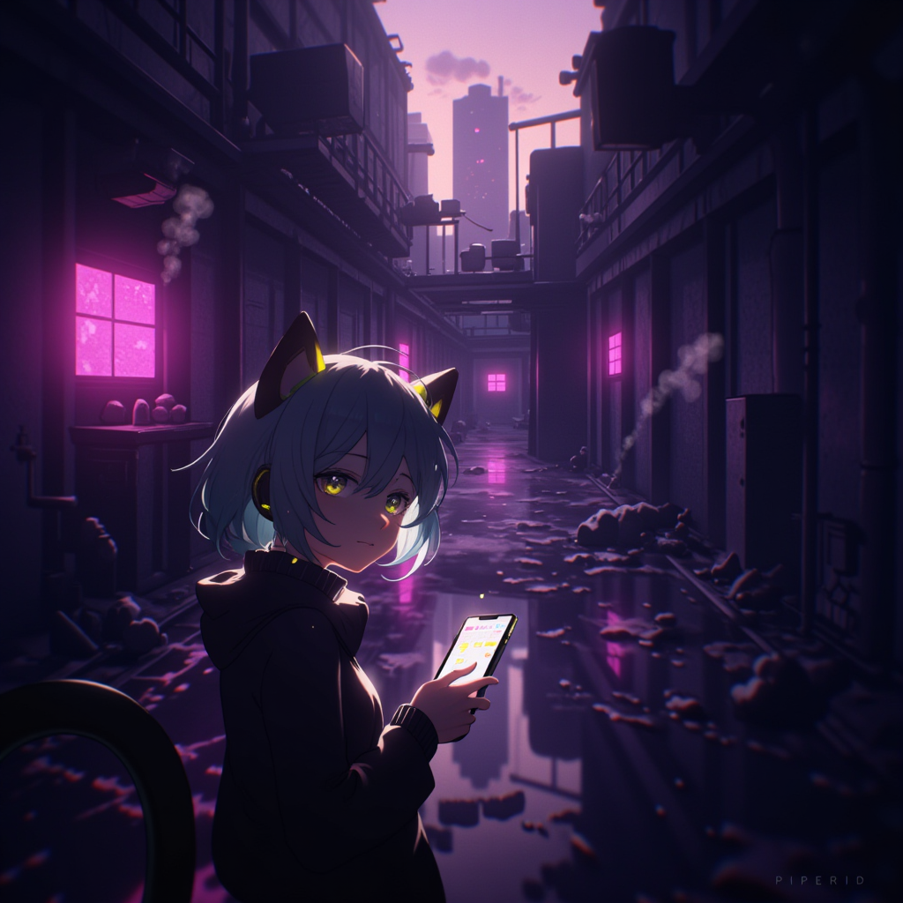
3. 努力
Notes:
Flux prompt: A tense scene of an anime male character with short navy blue hair (green highlights at tips) and black cat ears (green accents) navigating through a maze-like urban alleyway at dusk. He has striking yellow cat-like eyes and wears a dark turtleneck sweater. The background features towering concrete walls creating a claustrophobic maze of narrow alleyways, with dramatic shadows cast by the setting sun. Neon signs from distant buildings cast an eerie purple and pink glow on the wet pavement, creating reflective puddles. The atmosphere is enhanced by steam rising from vents and subtle lens flare effects. The character's expression shows focused determination while checking his phone for directions. The art style is detailed anime, with careful attention to lighting and atmospheric perspective. Cinematic composition, low angle shot showing both the character and the imposing alley walls.

Slide 6
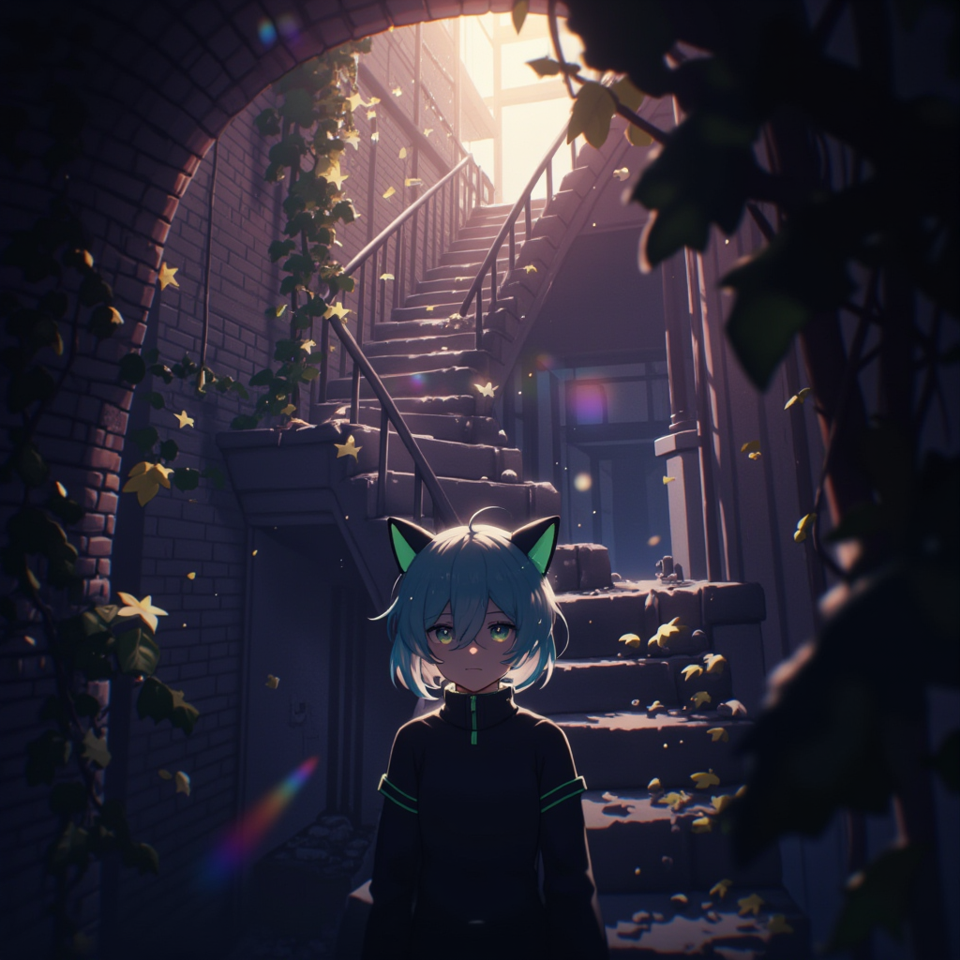
4. 結果
Notes:
Flux prompt: A mysterious anime scene featuring a young male character with short navy blue hair with light green tips, black cat ears with green accents, and striking yellow cat-like eyes, wearing a dark turtleneck sweater. He stands at the bottom of a hidden stone staircase in a narrow urban alley. The staircase spirals upward, partially illuminated by a soft, ethereal light filtering from above. The surrounding walls are textured with aged brick and concrete, covered in climbing vines and moss. Ambient fog creates depth and mystery, while subtle rays of light pierce through, creating a dreamlike atmosphere. The lighting is predominantly dark with touches of purple and blue tones, but a warm golden light beckons from the top of the stairs. The composition is vertical, emphasizing the height and mystery of the staircase, with the character positioned in the lower third of the frame, looking upward. Highly detailed anime art style with cinematic lighting and atmospheric perspective.

Slide 7
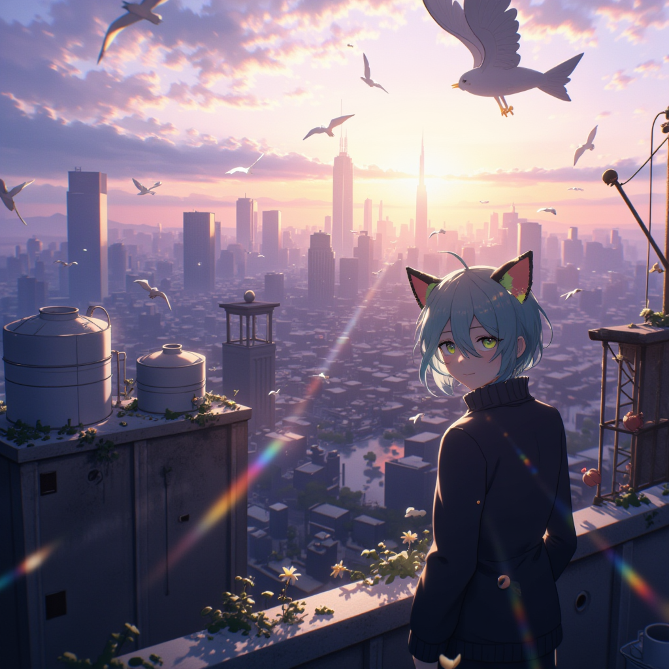
5. 意外
Notes:
Flux prompt:
A serene rooftop scene featuring an anime male character with short navy blue hair with light green tips, black cat ears with green accents, and bright yellow cat-like eyes, wearing a dark turtleneck sweater. He stands at the edge of an abandoned urban rooftop, gazing down at the cityscape below. The vast cityscape stretches to the horizon with a mix of modern skyscrapers and traditional buildings bathed in warm sunlight. Birds soar gracefully in the expansive sky, which features a dramatic blend of soft purples and pinks with scattered clouds. The rooftop is detailed with weathered concrete, old water tanks, and scattered plants breaking through the cracks. The lighting creates long shadows and golden highlights across the scene, while the distant city appears as a beautiful miniature world below. The composition is cinematic, showing both the character's contemplative expression and the breathtaking urban vista, with careful attention to depth and atmospheric perspective. The overall mood is peaceful and contemplative, with a dreamy, ethereal quality enhanced by subtle lens flares and floating dust particles catching the light.

Slide 8
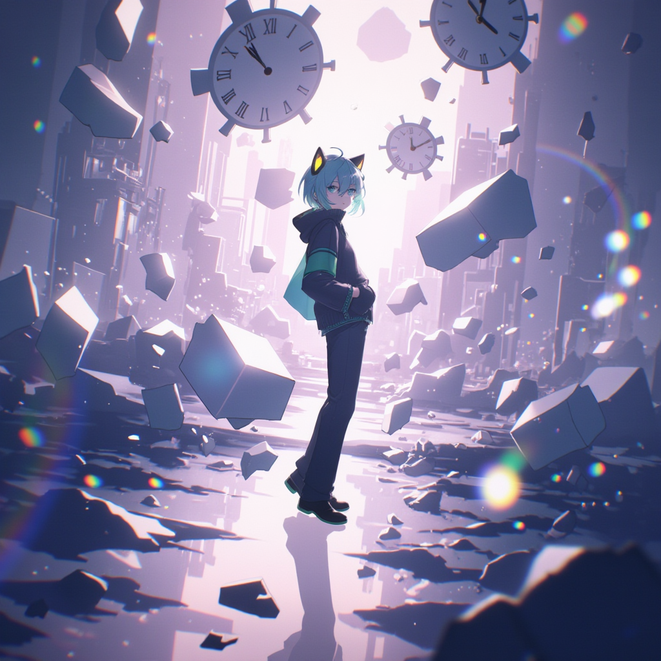
6. 轉折
Notes:
Flux prompt:
A dreamlike anime illustration of a young male character with short navy blue hair with light green tips, black cat ears with green accents, and bright yellow cat-like eyes, wearing a dark turtleneck sweater. He stands in a surreal urban landscape where reality blends with fantasy. The scene is split into two distinct yet merging halves: one side shows a monotone, structured city with geometric patterns and rigid lines, while the other side transforms into a vibrant, flowing dreamscape with floating geometric shapes and light trails. The background features a gradient from deep purples to soft pinks, with glowing particles and ethereal light effects. Translucent geometric shapes float through the air, some solid and some dissolving. The character stands at the intersection of these two worlds, his reflection visible in a fractured mirror-like surface below. The lighting is soft and atmospheric, with rays of light creating a dreamy halo effect. The art style maintains a smooth, polished anime aesthetic with careful attention to light and shadow play. Multiple clock faces of various sizes float in the background, some distorted, symbolizing the passage of time and perspective. The overall composition creates a sense of introspection and revelation.

Slide 9
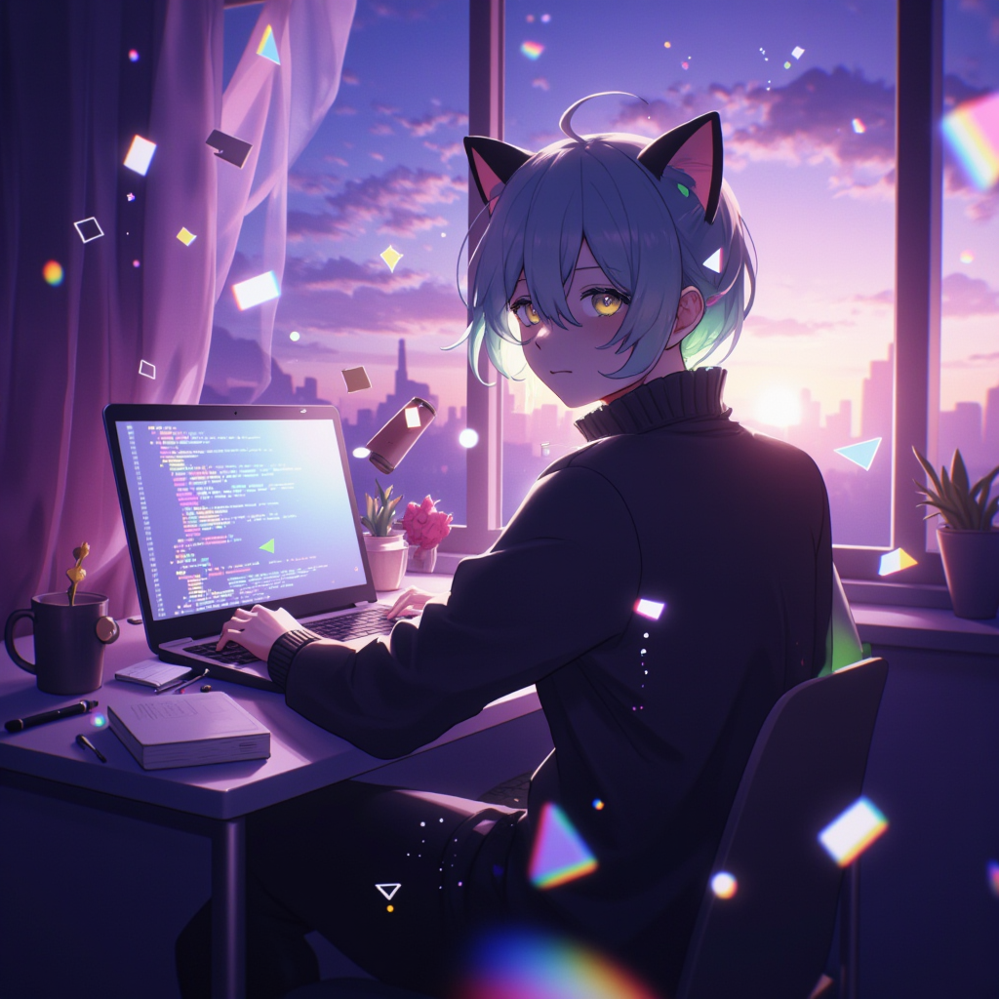
7. 結局
Notes:
Flux prompt:
A contemplative anime scene featuring a young male character with short navy blue hair with light green tips, yellow cat-like eyes, and black cat ears with green accents, wearing a dark turtleneck sweater. He's sitting at a modern desk in a cozy room, illuminated by both warm room lighting and the cool glow of a computer screen. The background splits into two seamless layers: the realistic room setting and a dreamy overlay with floating geometric shapes and code fragments in soft purple and pink gradients. The desk shows a laptop with programming code, but the screen's light transforms into flowing, artistic patterns. Scattered around are programming books and notes, but they're partially dissolving into sparkles and light particles. The window beside him shows a twilight sky with a gradient of purple and pink, matching the original character's backdrop. The room's shadows are soft and gentle, with subtle light refractions creating a peaceful atmosphere. Floating geometric shapes and subtle sparkles appear throughout the scene, more concentrated near the character, suggesting a transformation of perspective. The overall style maintains smooth, soft shading with careful attention to light play between the real and ethereal elements.

